Slide 1
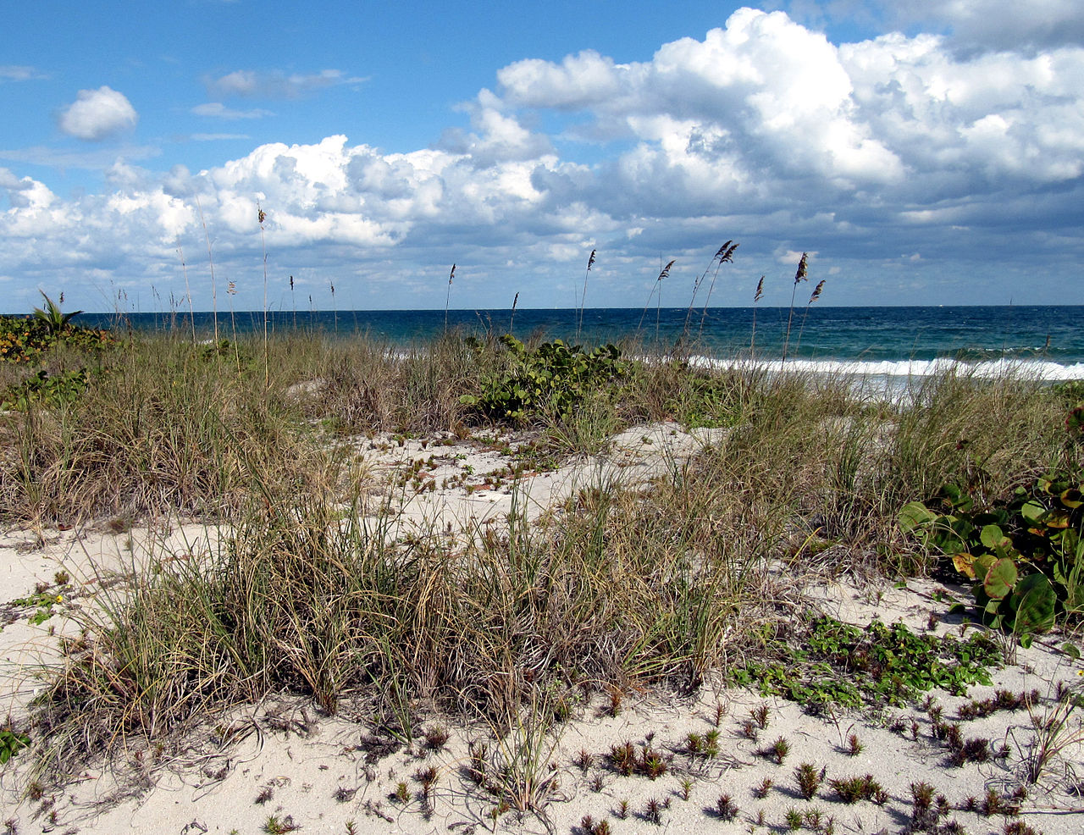
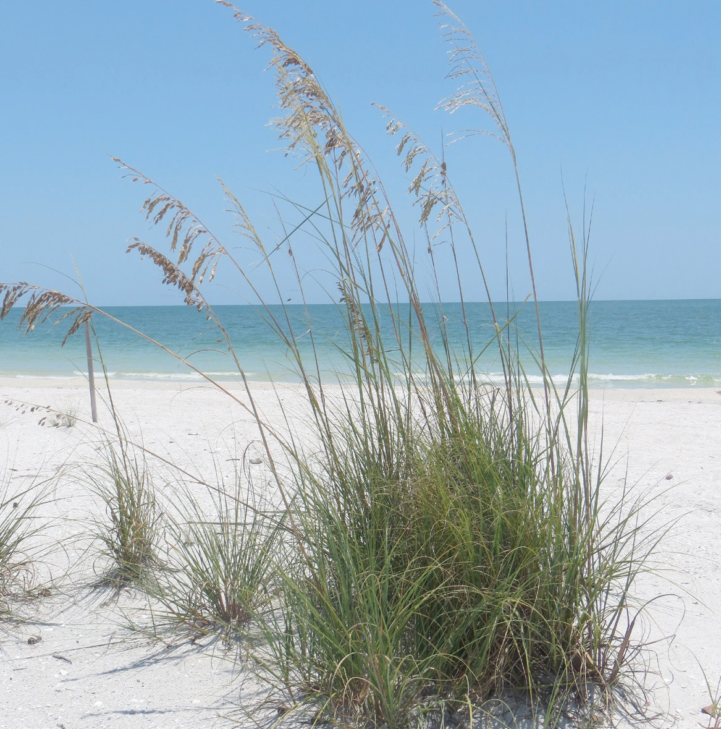
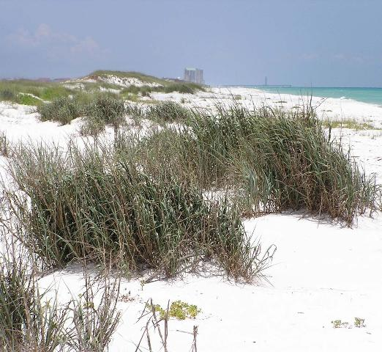
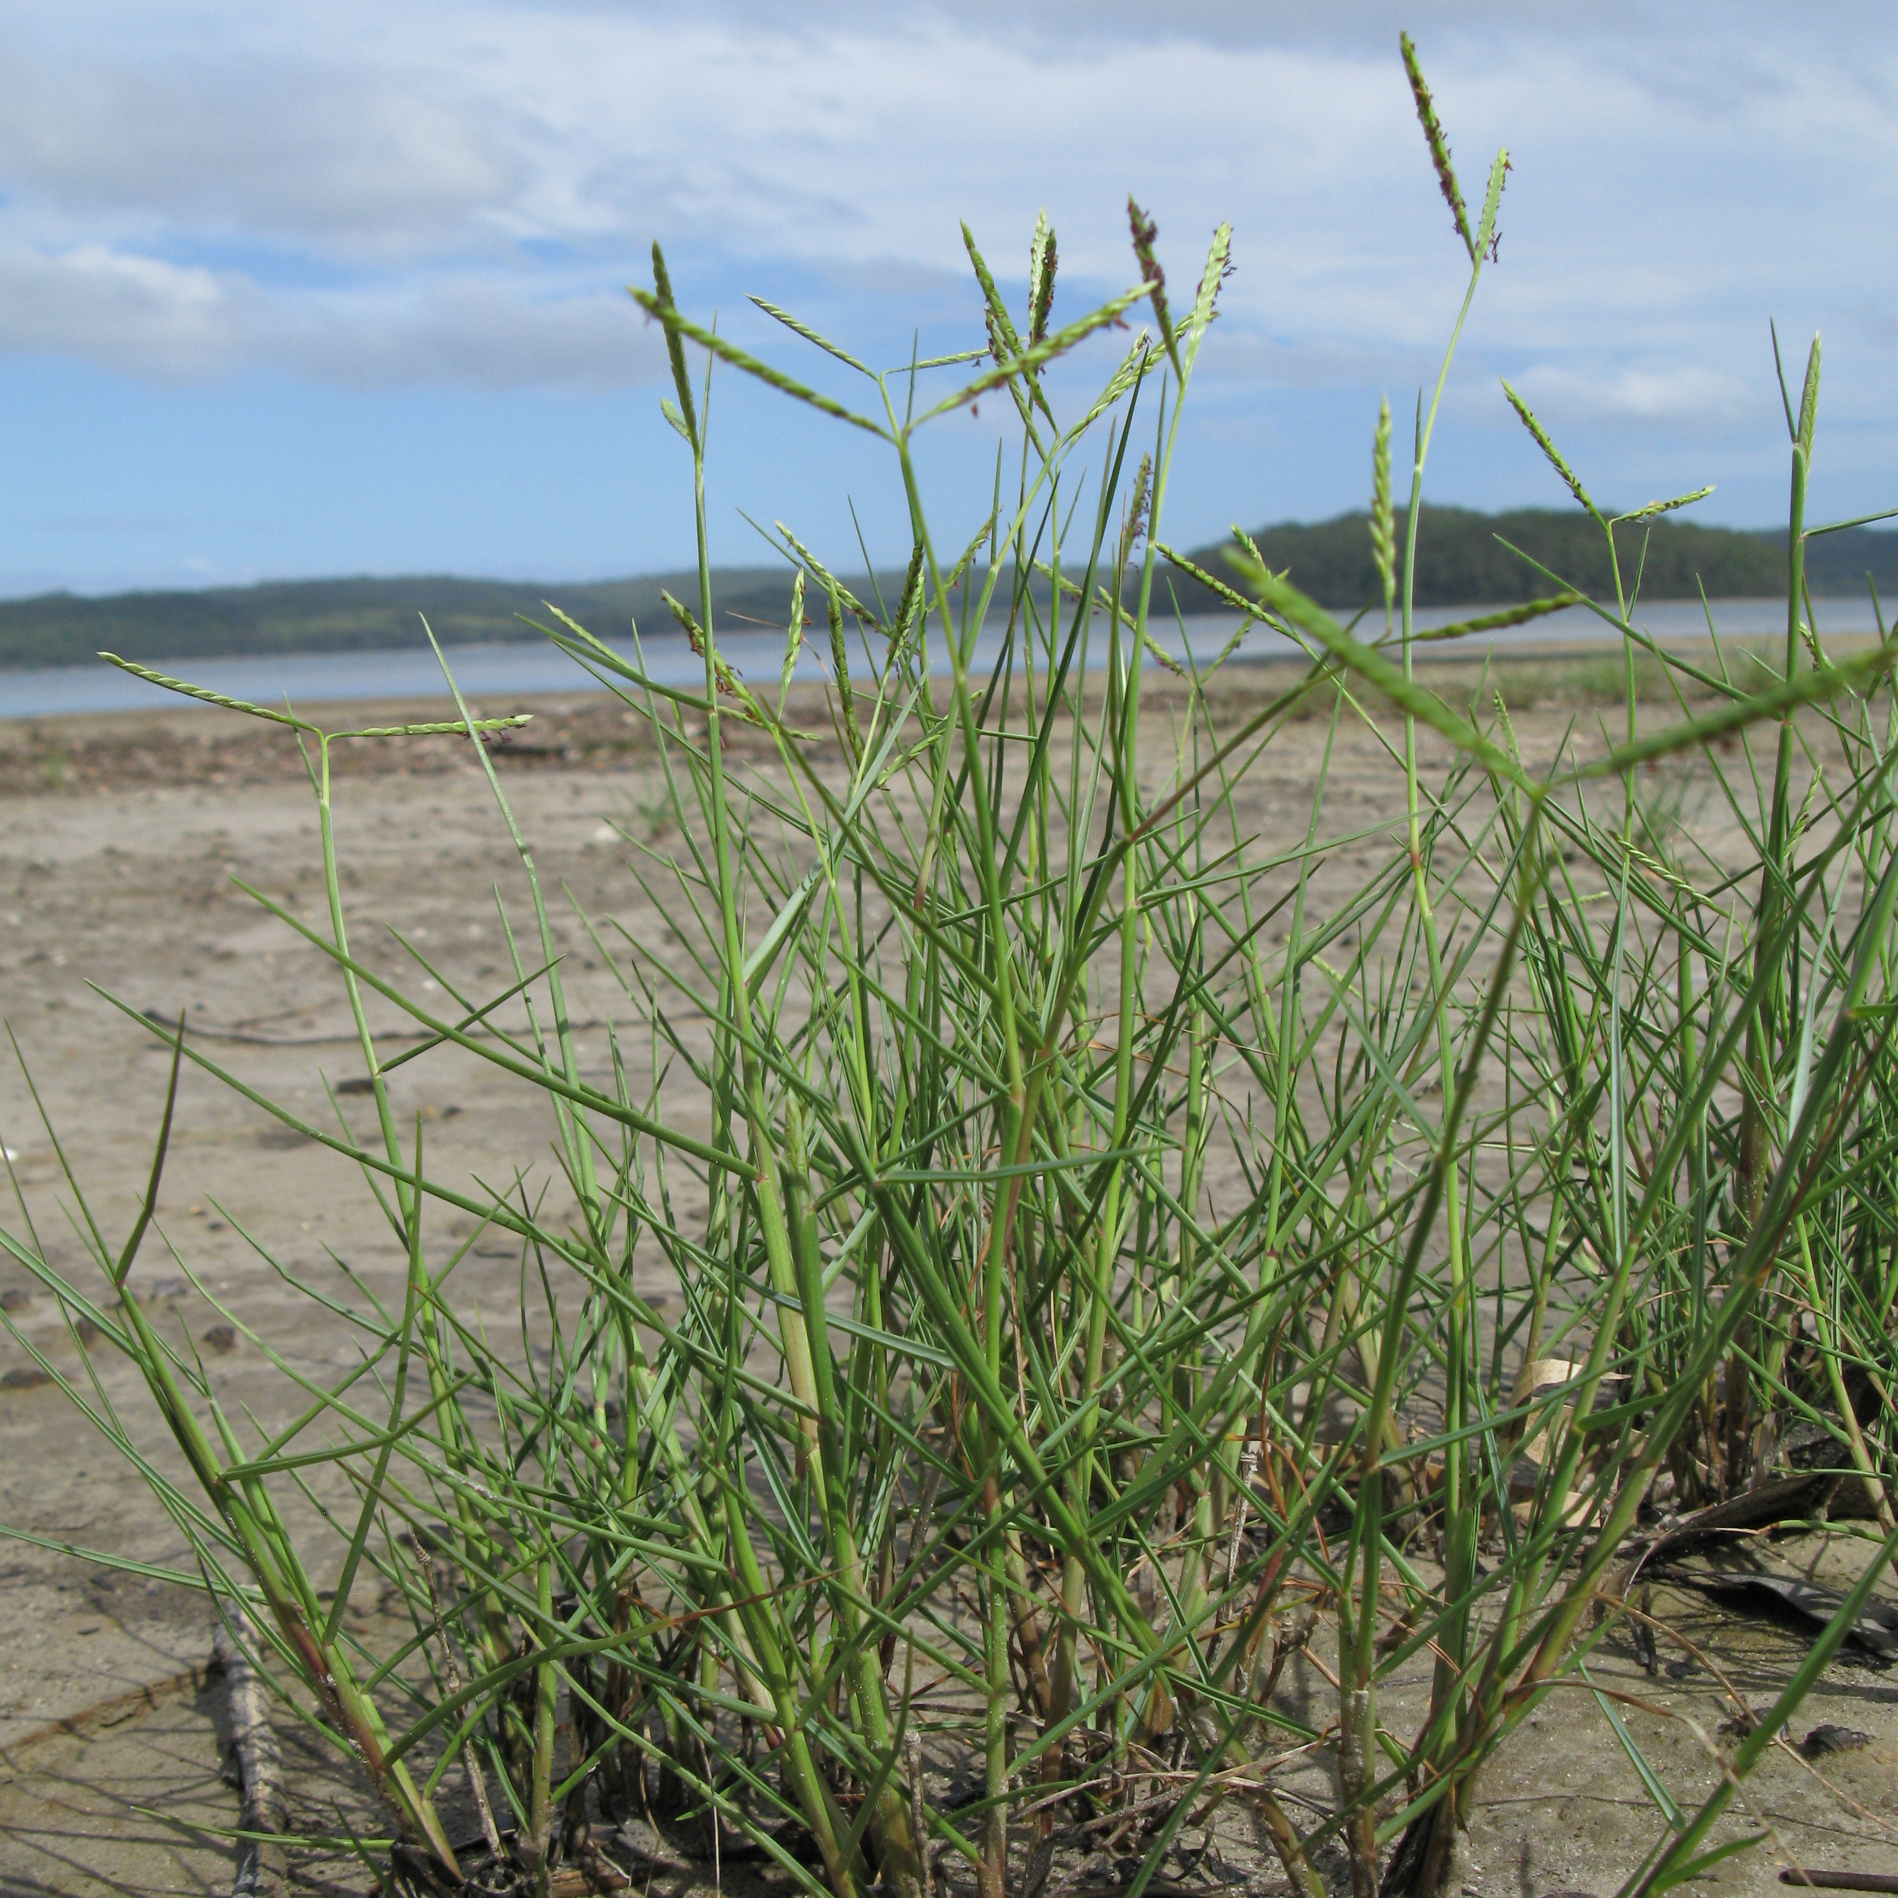
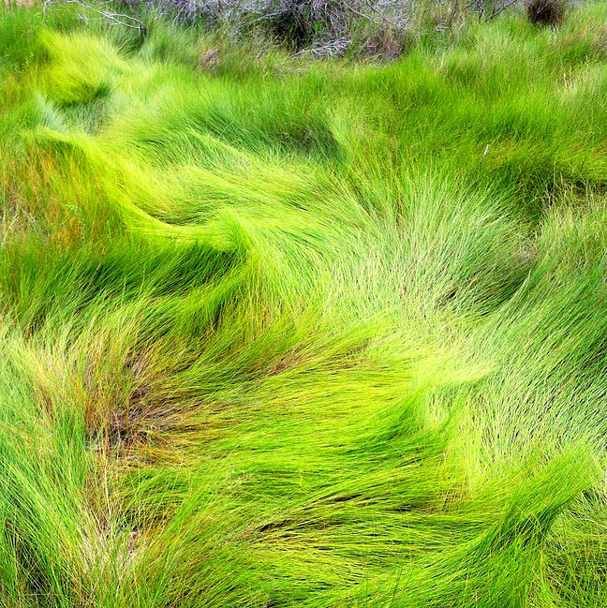
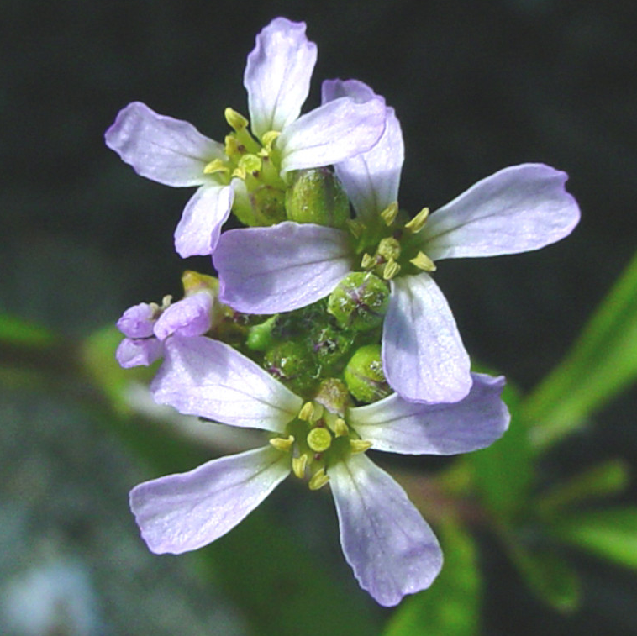
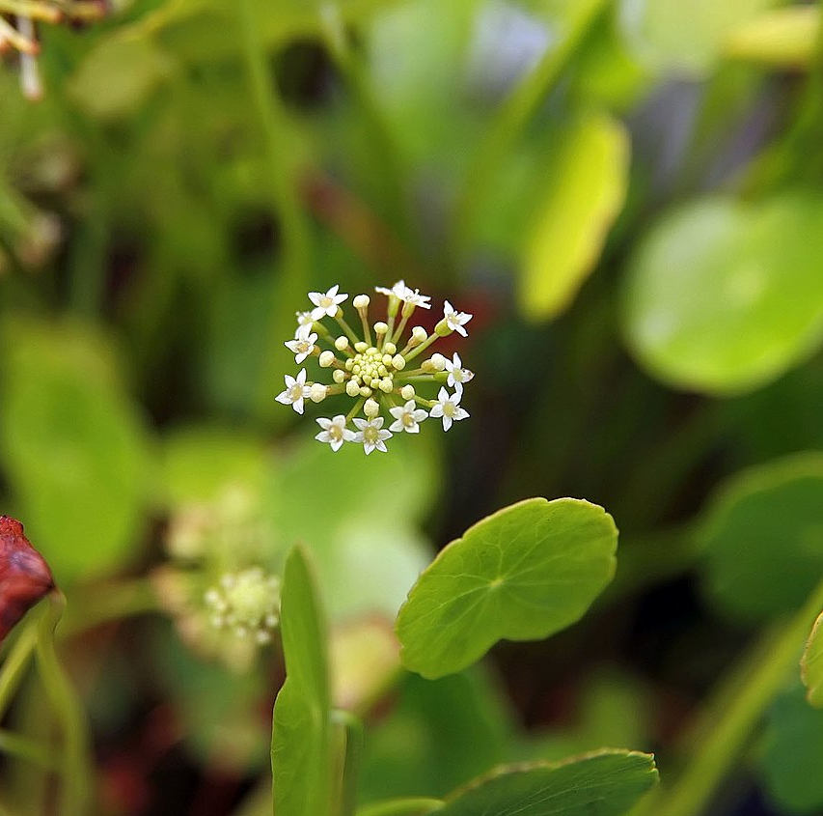
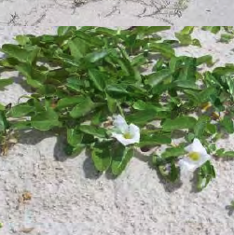
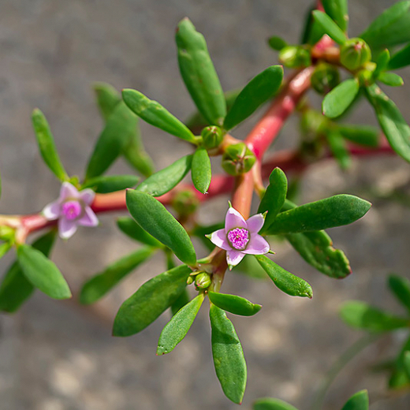
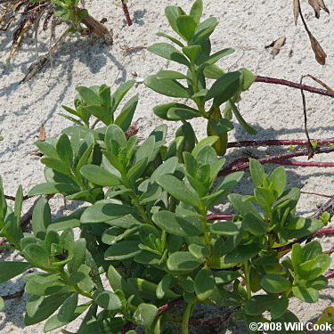
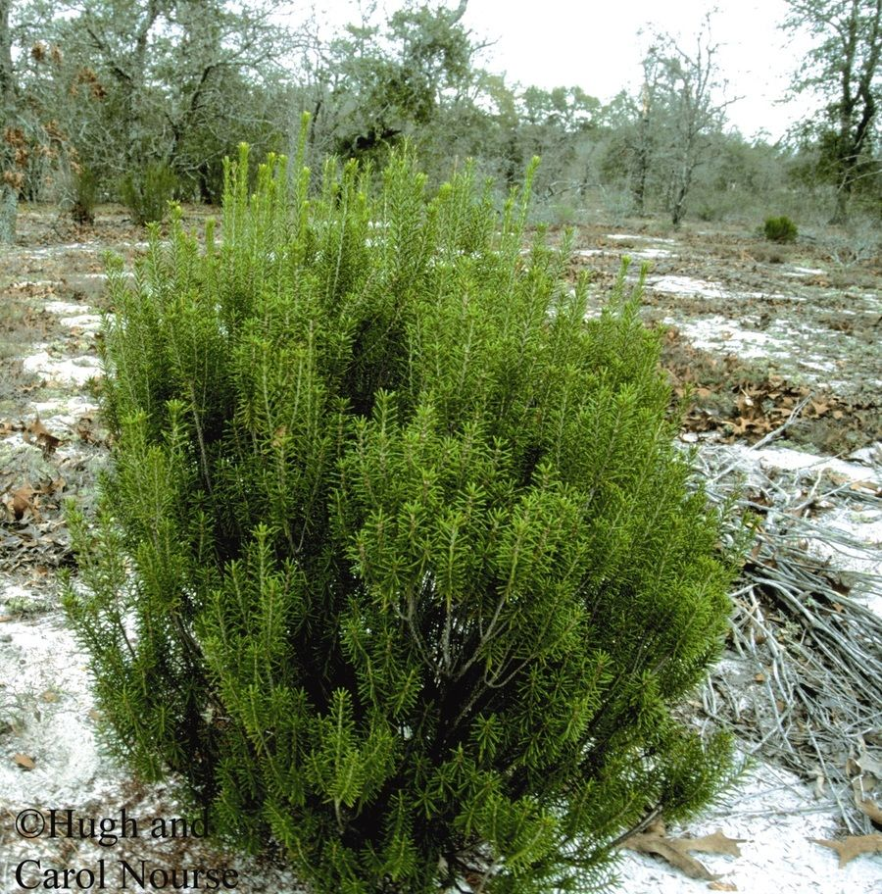
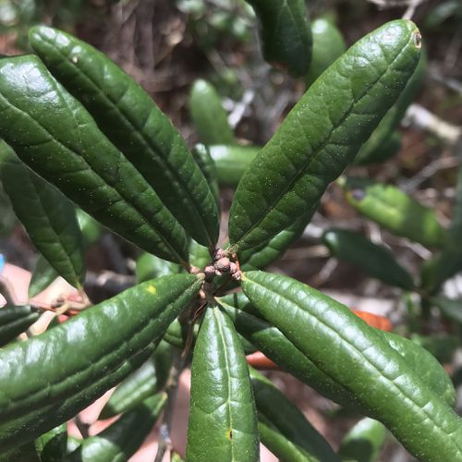
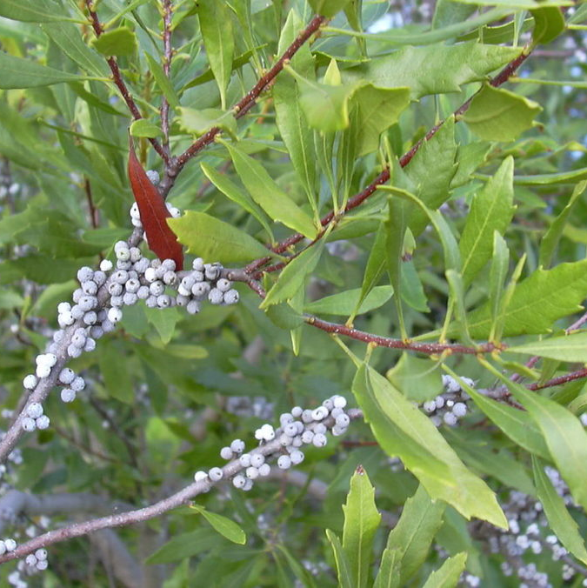
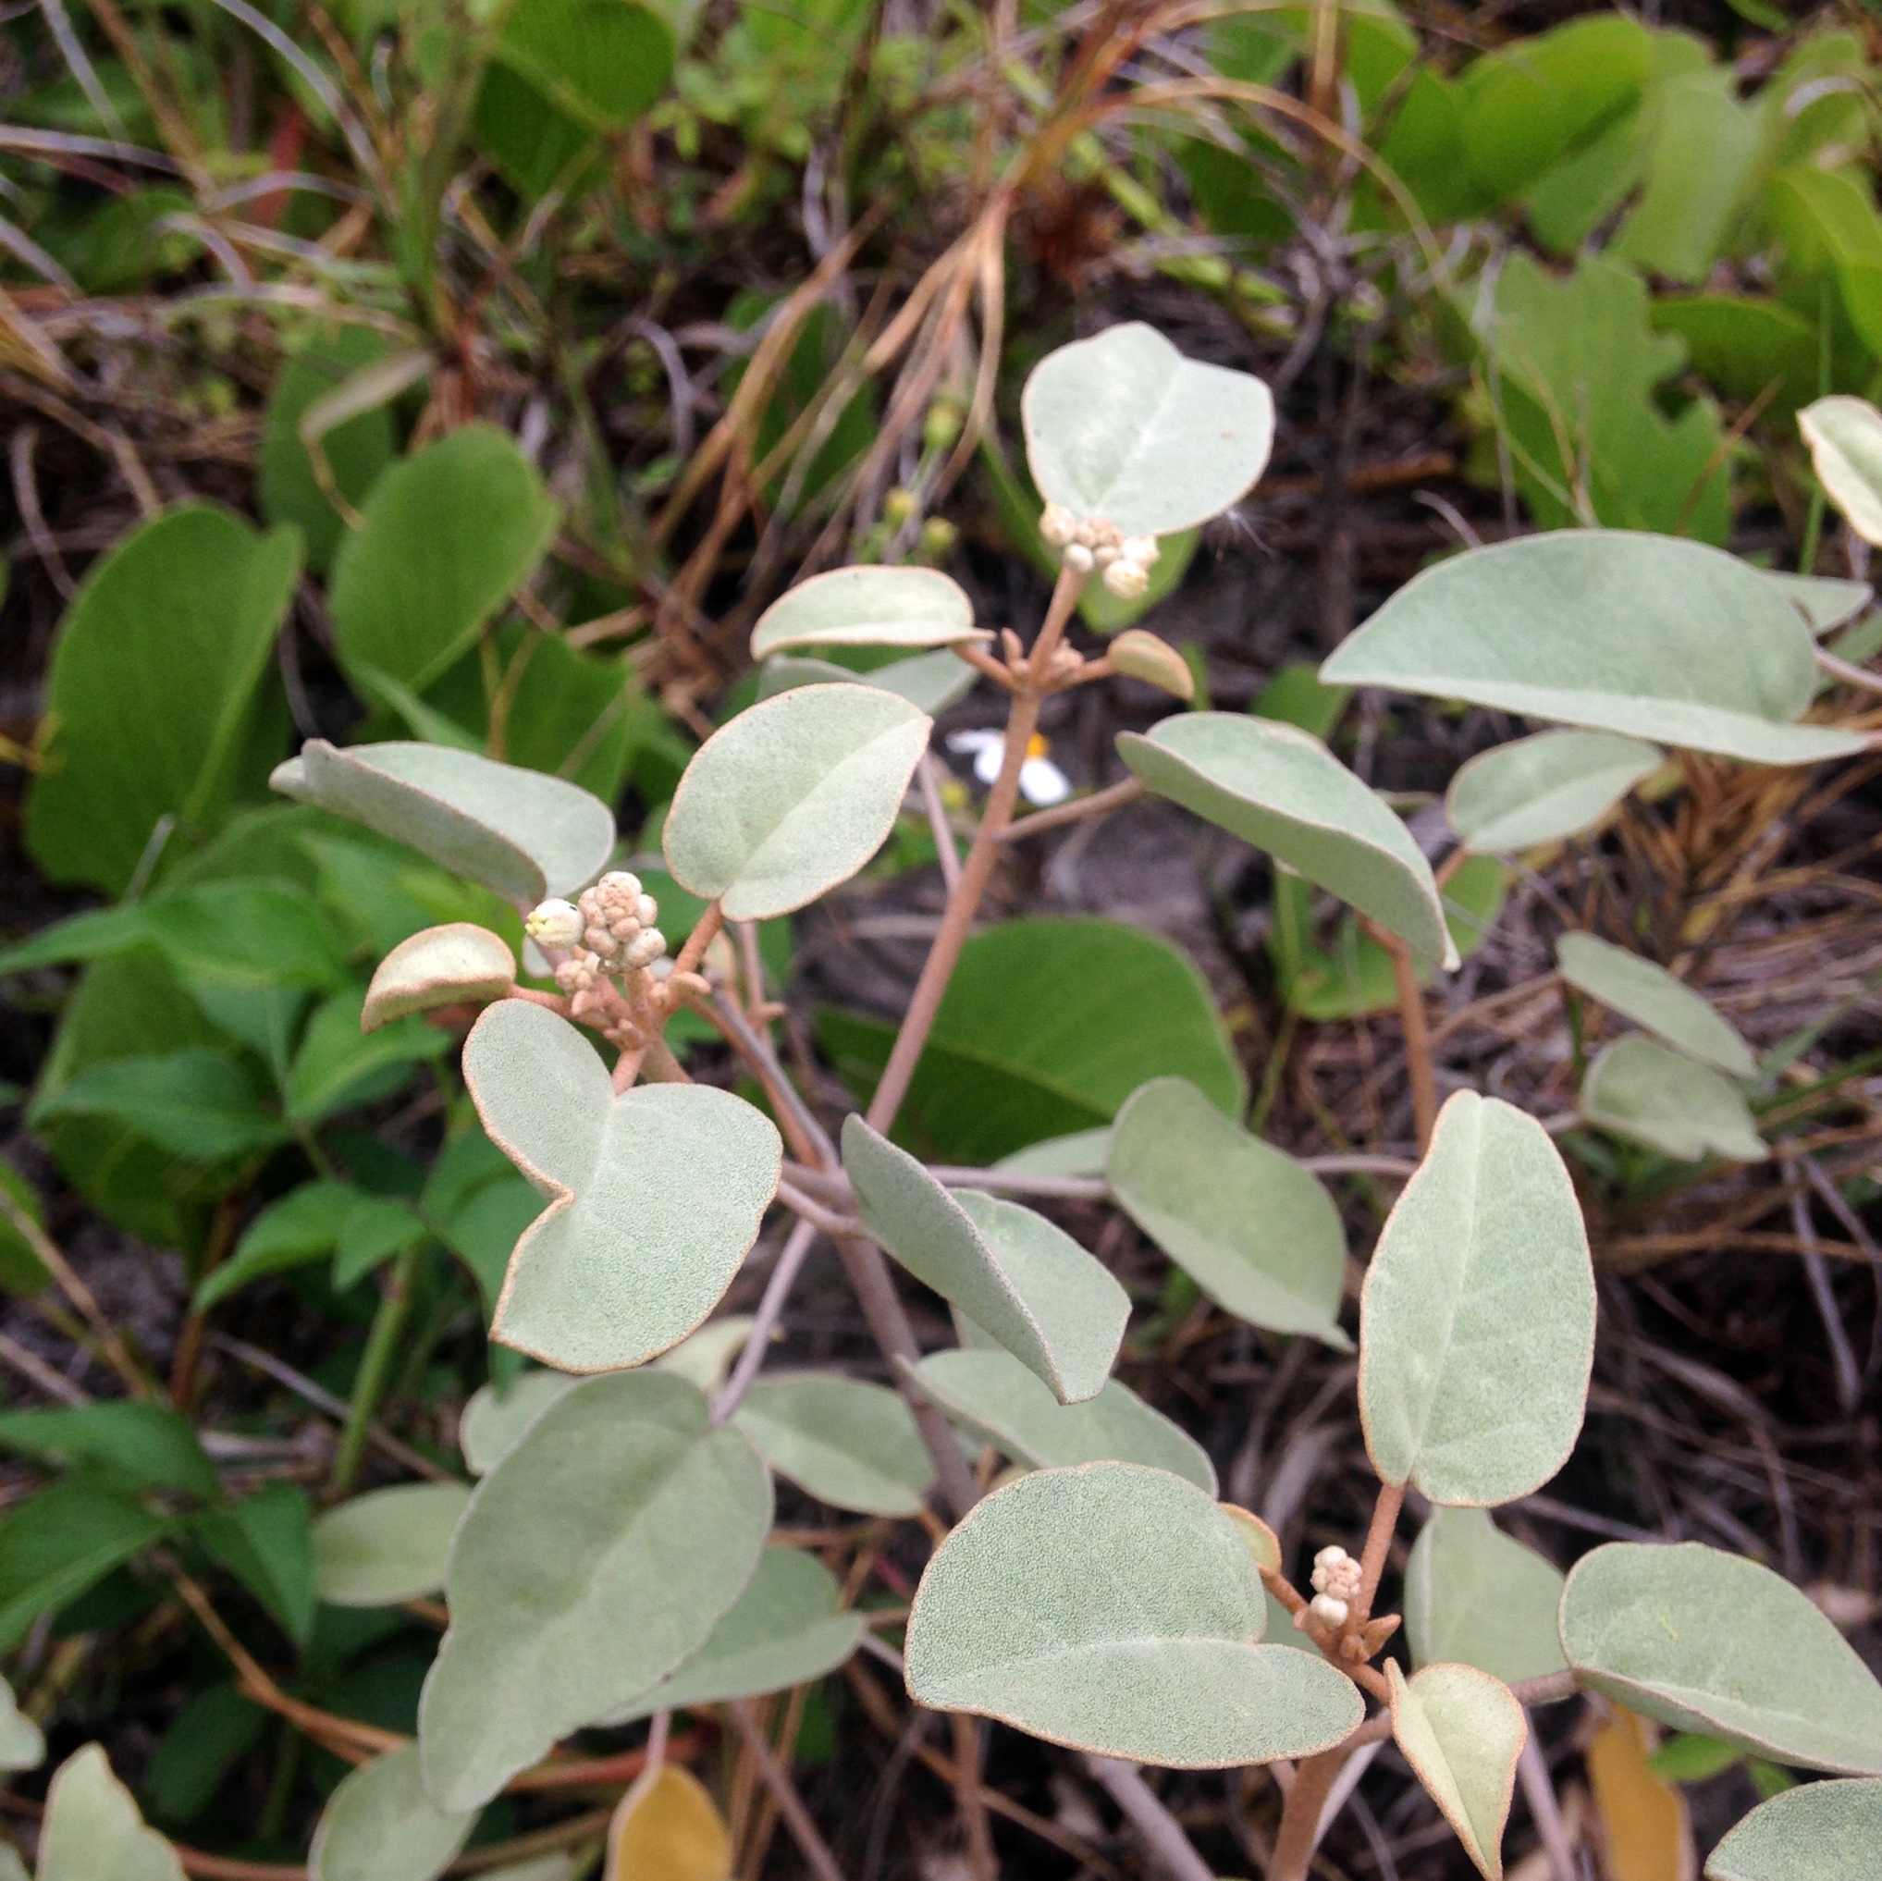
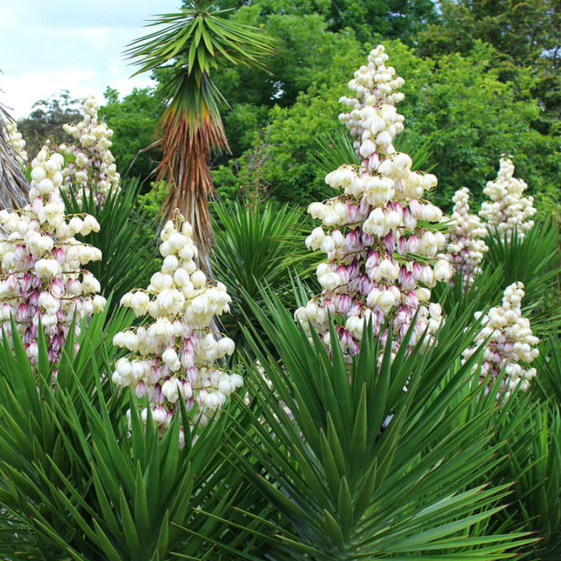







Predicting the responses of Northern Gulf of Mexico coastal dune plant communities to climate change using ecological niche modeling
ENM Problem
Formulation /
Workflow
Ecological models predict dune plant distributions will be severely
limited by climate change
B
PRESENTER:
Justin C. Bagley, Ph.D.
A
Step 1 (O)
Modeling objective?
Taxon, location?
Conceptual approach
Software, code, data
Evaluate predictive performance and significance through additional data collection or data-splitting (statistical tests, AUC, Kappa)
Step 4
(A)
BACKGROUND
Sandy dune habitats of the Northern Gulf of Mexico (NGOM) support diverse biotic communities and provide valuable ecosystem services to humans.
Unfortunately, coastal dune ecosystems are declining globally due to multiple interacting stressors, including global climate change (GCC) ¹.
Q: How will dune plant species respond to GCC?
Ecological niche models (ENMs) predict past, present, and future distributional areas (suitable habitats) of species, thus are useful for addressing this question ².
OBJECTIVE
Assess the severity of GCC impacts by modeling bioclimatic niches of 14 native dune plant species of the NGOM with overlapping distributions.
METHODS
DATA COLLECTION / PREPARATION
Obtain species occurrences (presence-only records) from Global Biodiversity Information Facility (GBIF) for all 14 species.
Clean occurrences (remove duplicates, run CoordinateCleaner, and spatially thin to 10–50 km).
Obtain environmental variable data layers, stack rasters, cut to 100–200 km buffer zone ^{3,4}.
Current environments: WorldClim v2.1, 30-s data ⁴.
Future environments: CMIP5 2070 data, 30-s data (CESM1-CAM5-1-FV2 circulation model, RCP 4.5 scenario) ³.
Assess correlations between env. predictor variables (Pearson’s r, spoke plots); make reduced datasets of variables with r < 0.9.
ECOLOGICAL NICHE MODELING (ENM) ^{1,5–8}
ENM analysis – maximum entropy (MaxEnt) algorithm ² in R using dismo ⁹.
Model performance: AUC curves.
Full (20-var.) vs. reduced (6—12-var.) models.
MODEL PROJECTION, TUNING, AND EVALUATION
Project models onto current layers and future climate layers (2070, RCP 4.5).
Compare predicted current bioclimatically suitable habitat against that under global climate change, i.e. year 2070 predictions.
Step 2
(D)
Collate species occurrence data (localities where species has been observed or is known to be absent)
Step 3 (M)
Collate GIS database of environmental layers (e.g. temperature, precipitation, soils)
Process environmental layers to generate predictor variables important in defining species distributions
Apply modeling algorithm (e.g. machine learning, GLM, regression trees)
Map prediction in geographic space (G)
Model calibration (select suitable parameters, test importance of alternative predictor variables, set threshold for binary prediction)
Predict species potential distribution in a different region (e.g. for invasive species) or different time period (e.g. under climate change scenarios)
Step 5
(P)
Figure 3. Five-step ENM flow diagram (A; redrawn and modified after ²) and BAM diagram (B) showing factors influencing species distributional areas.
If possible, evaluate prediction against observed data, such as occurrence records in an invaded region, or distributional shifts over decades
future directions
Run ENMs using other global circulation models (GCMs) & IPCC representative concentration pathways (e.g. RCP v8.5).
Additional model evaluation and tuning.
Field-based validation of present-day ENMs to assess suitability–abundance or suitability–fitness correlations.
Population genomics of local adaptation.
SPECIES
Table 1. Focal plant species and their most likely zone of occurrence on dunes ¹⁰.
ENM prediction of future distributions of adaptive genetic variation.
Mapping of gene–environment match/mismatches to predict most impacted areas under GCC ^{cf. 11}.
Group |  | Species (Common & Scientific names) | Foredune zone | Backdune zone
Grasses
1. | Sea oats Uniola paniculata L. | Sea oats Uniola paniculata L. | x
2. | Bitter panicum Panicum amarum Ell. | Bitter panicum Panicum amarum Ell. | x
3. | Seashore paspalum Paspalum vaginatum Sw. | Seashore paspalum Paspalum vaginatum Sw. | x
4. | Saltmeadow cordgrass Spartina patens (Ait.) Muhl. | Saltmeadow cordgrass Spartina patens (Ait.) Muhl. | x
Other herbaceous plants
5. | Searocket Cakile maritima Scop. | Searocket Cakile maritima Scop. | x
6. | Largeleaf pennywort Hydrocotyle bonariensis Lam. | Largeleaf pennywort Hydrocotyle bonariensis Lam. | x | x
7. | Beach morning glory Ipomoea pes-caprae (L.) R. Brown | Beach morning glory Ipomoea pes-caprae (L.) R. Brown | x
8. | Seapurselane Sesuvium portulacastrum (L.) L. | Seapurselane Sesuvium portulacastrum (L.) L. | x
Trees and shrubs
9. | Seacoast marshelder Iva imbricata Walt. | Seacoast marshelder Iva imbricata Walt. | x
10. | Florida rosemary Ceratiola ericoides Michx. | Florida rosemary Ceratiola ericoides Michx. |  | x
11. | Sand live oak Quercus geminata Small | Sand live oak Quercus geminata Small |  | x
12. | Waxmyrtle Morella cerifera L. | Waxmyrtle Morella cerifera L. |  | x
13. | Gulf croton Croton punctatus Jacq. | Gulf croton Croton punctatus Jacq. |  | x
14. | Aloe yucca Yucca aloifolia L. | Aloe yucca Yucca aloifolia L. | x
1. Uniola paniculata
2. Panicum amarum
3. Paspalum vaginatum
4. Spartina patens
5. Cakile edentula
6. Hydrocotyle bonariensis
7. Ipomoea pes-caprae
REFERENCES
Defeo, O., McLachlan, A., Schoeman, D.S., Schlacher, et al., 2009. Threats to sandy beach ecosystems: a review. Estuarine, Coastal and Shelf Science, 81, 1–12.
Peterson, A.T., Soberón, J., Pearson, R.G., Anderson, R.P., et al., 2011. Ecological Niches and Geographic Distributions (MPB-49). Princeton University Press, New York.
Hijmans, R.J., Cameron, S.E., Parra, J.L., Jones, et al., 2005. Very high resolution interpolated climate surfaces for global land areas. International Journal of Climatology, 25, 1965–1978.
Hijmans, R.J., 2021. raster: Geographic Data Analysis and Modeling. R package version 3.4-13. Available at: https://CRAN.R-project.org/package=raster.
Elith, J., Graham, C.H., Anderson, R.P., Dudík, et al., 2006. Novel methods improve prediction of species’ distributions from occurrence data. Ecography, 29(2), 129–151.
Phillips, S.J., Anderson, R.P., Schapire, R.E., 2006. Maximum entropy modeling of species geographic distributions. Ecological Modelling, 190(3-4), 231–259.
Merow, C., Smith, M.J., Silander, J.A. Jr., 2013. A practical guide to MaxEnt for modeling species' distributions: What it does, and why inputs and settings matter. Ecography, 36, 1058–1069.
Phillips, S., 2021. maxnet: Fitting 'Maxent' Species Distribution Models with 'glmnet'. R package version 0.1.4. Available at: https://CRAN.R-project.org/package=maxnet.
Hijmans, R.J., Phillips, S., Leathwick, J., Elith, J., 2020. dismo: Species Distribution Modeling. R package version 1.3-3. Available at: https://CRAN.R-project.org/package=dismo.
Williams, MJ., 2007. Native plants for coastal dune restoration: what, when and how for Florida. USDA NRCS, Brooksville Plant Materials Center, Brooksville, FL.
Exposito-Alonso, M., Vasseur, F., Ding, W., Wang, G., et al., 2018. Genomic basis and evolutionary potential for extreme drought adaptation in Arabidopsis thaliana. Nature Ecology and Evolution, 2, 352–358.
Foredune species
Backdune species
8. Sesuvium portulacastrum
9. Iva imbricata
10. Ceratiola ericoides
11. Quercus geminata
12. Morella cerifera
13. Croton punctatus
14. Yucca aloifolia
RESULTS and discussion
CURRENT PREDICTION, REDUCED DATASET
FUTURE (2070) PREDICTION, REDUCED DATASET
CHANGE IN HABITAT SUITABILITY (HS)
Species |  | Full | Reduced | Full | Reduced
 |  | model | model | model | model
No | Name | AUC | AUC | Present to 2070 Trend | Present to 2070 Trend
1 | Uniola paniculata | 0.975 | 0.940 | drastically reduced | expansion
2 | Panicum amarum | 0.910 | 0.887 | drastically reduced | reduced
3 | Paspalum vaginatum | 0.964 | 0.953 | reduced | reduced
4 | Spartina patens | 0.910 | 0.901 | drastically reduced | drastically reduced
5 | Cakile edentula | 0.925 | 0.917 | drastically reduced | reduced
6 | Hydrocotyle bonariensis | 0.900 | 0.879 | drastically reduced - southern expansion/refugium | drastically reduced - southern expansion/refugium
7 | Ipomoea pes-caprae | 0.905 | 0.868 | drastically reduced | reduced
8 | Sesuvium portulacastrum | 0.911 | 0.876 | drastically reduced | drastically reduced
9 | Iva imbricata | 0.976 | 0.976 | reduced | reduced
10 | Ceratiola ericoides | 0.942 | 0.922 | reduced | reduced/equal - northward expansion/refugium
11 | Quercus geminata | 0.943 | 0.929 | drastically reduced - northward expansion/refugium | reduced/equal - northward expansion/refugium
12 | Morella cerifera | 0.797 | 0.777 | drastically reduced | reduced/equal - northward expansion/refugium
13 | Croton punctatus | 0.888 | 0.860 | expansion | somewhat reduced
14 | Yucca aloifolia | 0.945 | 0.923 | drastically reduced - northward expansion/refugium | reduced/equal - northward expansion/refugium
A
1. Uniola paniculata
Habitat
suitability
Habitat
suitability
(Δ % max. habitat suitability)
high
Expansion
high
high
Latitude
low
low
low
Table 2. Summary of model evaluation statistics and qualitative interpretations from comparing current vs. future (2070, GCC) MaxEnt model predictions. Area under the Receiver Operating Characteristic curve (AUC) statistics for each ENM are metrics for model evaluation, with higher values indicating greater predictive ability. “Present to 2070 Trend” columns describe changes in predicted habitat suitability (HS) between ‘current’ conditions (modern 1950–2000 data) and 2070 conditions representing GCC based on the IPCC RCP v4.5 scenario of global CO₂ emissions. Reduced models based on less correlated variables were preferred.
B
Longitude
Habitat
suitability
Longitude
Habitat
suitability
Longitude
ACKNOWLEDGEMENTS
We thank the JSU College of Science and Mathematics for providing space, computational resources, and IT support during this project. Additionally, we thank the JSU Department of Biology for providing funding for equipment (4 TB external hard drives) used during this research.
Reduction
high
high
high
Ecological Niche Modeling (ENM) Overview ^{2,6}
Mining GBIF records in R yielded a total of 600–11,950 raw occurrence records per species (museum specimens ≠ citizen science obs.). Data cleaning procedures reduced these to 129–438 occurrences per species with reduced spatial bias. Analyzing cleaned occurrences with either the full vs. reduced datasets yielded broadly similar models for each species with good—excellent predictive ability overall (mean AUC = 0.911, range = 0.777–0.976; Table 2). Projecting ENMs onto current conditions revealed good agreement with species known distributions. Model comparisons revealed four major trends in predicted habitat suitability (HS) from current to 2070 conditions: (1) expansion of foredune species HS (e.g. U. paniculata, Fig. 2A); (2) reduction in foredune species HS (e.g. P. vaginatum, Fig. 2B); (3) drastic reductions in foredune/backdune species HS; and (4) northward or southward range expansions or shifts in HS in backdune species (e.g. Q. geminata, Fig. 2C). However, the dominant pattern among our preferred reduced models (9/14 species, 64%) was a trend of reductions in HS under GCC (Table 2 above).
Latitude
3. Paspalum vaginatum
low
low
low
Justin C. Bagley, Ashlynn Abernathy, Lacey Bell, Rachel E. Bonner, Laura K. Dease, Collier DeVaney, Macee J. Glick, Jackson Hall, Elizabeth A. Hughston, Miles Jones, Nathan Jones, Monquita King, Kayla Morrow, Jordan Peters, Maddie Prickett, Caleb West.
C
Longitude
Habitat
suitability
Longitude
Habitat
suitability
Longitude
AUTHORS
Code | Bioclimatic variable description
BIO1 | Annual Mean Temperature
BIO2 | Mean Diurnal Range [Mean of monthly (max temp–min temp)]
BIO3 | Isothermality (BIO2/BIO7) (* 100)
BIO4 | Temperature Seasonality (standard deviation * 100)
BIO5 | Max Temperature of Warmest Month
BIO6 | Min Temperature of Coldest Month
BIO7 | Temperature Annual Range (BIO5-BIO6)
BIO8 | Mean Temperature of Wettest Quarter
BIO9 | Mean Temperature of Driest Quarter
BIO10 | Mean Temperature of Warmest Quarter
BIO11 | Mean Temperature of Coldest Quarter
BIO12 | Annual Precipitation
BIO13 | Precipitation of Wettest Month
BIO14 | Precipitation of Driest Month
BIO15 | Precipitation Seasonality (Coefficient of Variation)
BIO16 | Precipitation of Wettest Quarter
BIO17 | Precipitation of Driest Quarter
BIO18 | Precipitation of Warmest Quarter
BIO19 | Precipitation of Coldest Quarter
elevation | Digital elevation model (DEM)
N-Range Shift
high
high
high
Latitude
11. Quercus geminata
Contact: jbagley@jsu.edu
x14 species
low
low
low
Take a picture or scan the QR code to download the full poster.
x2 predictor sets
= 28 models
Longitude
Longitude
Longitude
Website: bagleylab.com
Figure 1. ENM overview, including modeling process and WorldClim variable descriptions (table).
Figure 2. Exemplars of three major trends in habitat suitability predicted by our models. Continuous raw output from current ENMs (left) are compared against model projections onto 2070 GCC conditions (center). Change plots illustrate differences between these two rasters after reclassification to % max. habitat suitability (right; green, ≥5% expansion; red, ≤–5% reduction). See text for further details.
+ Model tuning on full datasets

